Slide 1
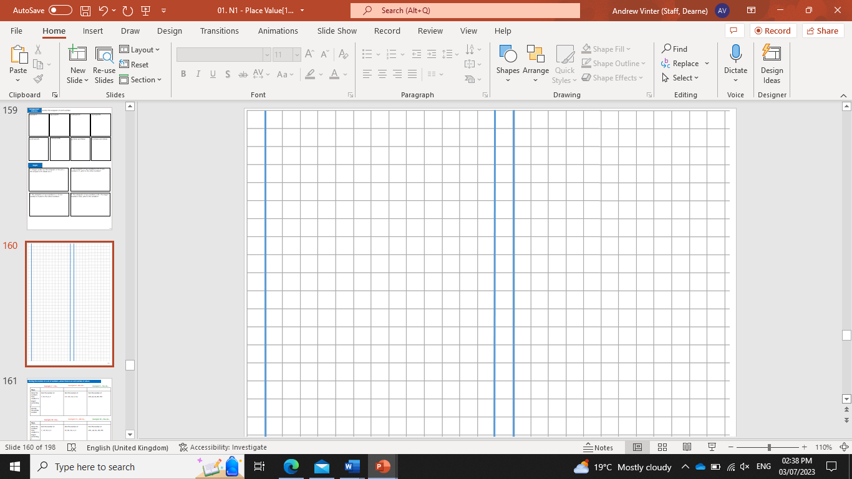
Subtopic N3.16 - Decimal Multiplication: Decimal by a Decimal
LEARNING OUTCOME: To understand how to multiply decimals by decimals
Objectives:
Keywords:
Multiply
Integer
Decimal
To be able to use formal methods of multiplication.
To be able to apply formal methods of multiplication to decimals.
To be able to use the knowledge of multiplication to solve problems in context.
Introduction – read and annotate:
When you multiply a decimal by another decimal, it works just like multiplying whole numbers—you
just need to place the decimal point correctly. You will use your knowledge of multiplying by 10, 100,
and 1,000 to make the numbers easier to work with. Correct place value is key to getting accurate
answers.
Multiplying two ‘zero point’ decimals
Example 1 – I do…
Example 2 – We do…
Example 3 – You do…
Steps
0.2
0.48
0.21
0.02
0.048
0.021
0.002
0.0048
0.0021

Slide 2
Independent Practice
Question 1. Work out the following:
0.06
0.14
0.36
0.48
0.49
0.3
0.4
0.2
0.08
0.035
0.008
0.056
0.054
0.0024
0.0024
0.0006
0.0018
0.0018

Slide 3
0.0048
0.002
0.00014
0.00072
0.00016
0.000015
Multiplying any two decimals
Example 4 – I do…
Example 5 – We do…
Example 6 – You do…
Steps
1.2
0.68
0.51
8.4
24.48
3.91
74.9
23.328
2.691

Slide 4
Independent Practice
Question 2. Work out:
1.55
1.89
3.78
5.52
4.32
7.68
11.83
42.35
7.31
46.06
0.091
0.144
0.486
0.0846
3.071
2.59
0.188
0.0228

Slide 5
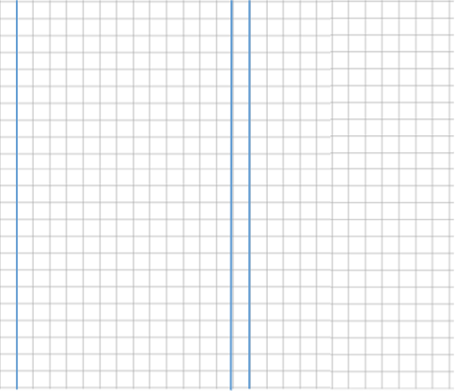
Question 3
0.0273
0.1008
0.405
1.806
8.448
1.666
2.3548
15.498
65.78
1.6017
1.4796
31.518

Slide 6
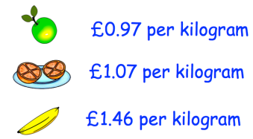
Independent Practice
Question 4 | Question 5
Mr.Jenkins is building a fence for his garden. The fence costs £12.60 per metre to build. The fence is 5.3 metres long. Work out the total cost of building the fence. | Joanne is baking some cupcakes for a party. The recipe states she needs 84.5g sugar to make 6 cupcakes. She wants to multiply each ingredient by 4.5 to make 27 cupcakes. How much sugar does she need?
Question 6 | Question 7
Here are the prices of some fruit in a shop. Find the total cost of 1.2kg of apples, 3.5kg of oranges and 1.9kg of bananas. | The area of a field is 94.8m²? Grass seed costs £2.50 per m². How much is the total cost?
£66.78
380.25g
£0.90
£1.70
£1.40
£9.69
£237

